Slide 1


Nazis on their Way to Power
Ceridwen Gulmohamed Alice Yardley Roland Clark Tim Grady
All sources are taken from Roland Clark and Tim Grady eds.,
European Fascist Movements: A Sourcebook (London: Routledge, 2023).

Slide 2
Learning Outcomes
Know and understand the factors influencing the rise of Nazism in Germany
Gain and deploy a historically grounded understanding of abstract terms such as paramilitarism, antisemitism, Empire
Understand historical concepts such as continuity and change, cause and consequence and use them to create structured accounts, including written narratives and analyses
Use evidence to make historical claims
Understand how gender shaped Nazi politics and actions

Slide 3
Brief Timeline
Fascism began in the 1920s in Italy, and Mussolini became the first fascist dictator.
January 1919: Drexler set up the German Workers Party which became the Nationalist Socialist German Workers Party in 1920 (also called the NSDAP, or the Nazi Party)
Hitler was born in Austria in 1889 and served in the First World War. He attended a NSDAP meeting in September 1919 and soon became the chairman due to party disputes and his oratory skills.
1923: Hitler arranged the unsuccessful Munich Putsch (influenced by the Italian March on Rome). He was arrested and wrote Mein Kampf (1925) in prison.
After his release in 1924, Hitler successfully reorganised the party and gain support through effective propaganda, encouraging the support of conservative elites who feared Communism.
In July 1932: the Nazi party won 230 seats and in January 1933 Hitler was appointed chancellor after several unsuccessful chancellors.

Slide 4
Nazi Ideology
Antisemitism: Hostility to or prejudice against Jewish people
Revisionism: Nazis blamed the “November Criminals” (members of the first Weimar government) for the loss of the First World War because they signed the Treaty of Versailles
Führer-myth: Hitler claimed he was a strong leader who would solve all Germany’s problems, such as unemployment

Slide 5
Source 1: Antisemitism
Bremen Police report on an NSDAP gathering in a Paulsburg restaurant, 12 June 1926.
The meeting, attended by some 100 people, was opened by the event organizer, Wegener, at about 8.55 in the evening. The floor was then given over to the Gymnasium school teacher Rust (Hannover), who spoke on the topic of “What does Hitler want?” Rust began by explaining that the people are missing a leader [Führer] to galvanize them. […] The decline of Germany is the fault of the Jews, who want to grab all the gold for themselves and then to illegally shift it offshore. When Wilson dictated his 12 Points, Rust continued, there were no less than 132 Jews surrounding him. And the Jews want Germany to disappear off the face of the earth. In all these years, he argued, it is the German worker who has suffered the most; he has lost everything, even his homeland. Say someone had worked in the same place for 20 years or more, but could no longer carry out his duties perfectly, his reward is to be kicked from behind and thrown out the door. Just as it used to be the case with industry, now it’s increasingly agriculture that is falling prey to the Jews. The speaker then turned to discuss the heavy burden of the Dawes agreement, which has further constrained the Germans. Before Germany has rid itself of these debts, it will already be in Jewish hands.

Slide 6
Questions
1. What does Source 1 tell us about why people might have supported the NSDAP in the early 1920s? Explain your answer.
2. What does Source 1 tell you about the beliefs of the NSDAP? Provide two examples.
3. What did the NSDAP blame Jewish people for? Why do you think people supported antisemitism?

Slide 7
Propaganda
Propaganda promotes a specific political idea and presents biased or misleading information to gain support.
Hitler effectively used rallies to show Nazi strength and gain support, delivered speeches and used posters with slogans such as ‘work and bread’ as well as antisemitic images.
Joseph Goebbels was appointed Minister of Propaganda in 1933.

Slide 8
Source 2
Joseph Goebbels, ‘10 Commandments for every SA Man’, 1926.
Remain faithful to the idea and to your leaders and every day play your part and do your damned duty. The leader guides and embodies the idea for which we serve. The first necessary condition for achieving victory is the discipline and loyal allegiance of the SA man to the leader. Hundreds of people, schooled in discipline and responsibility, are worth far more than a load of drifters. Therefore:
Be loyal to your leader until the last. You owe him your obedience and subordination, not simply for his sake, but for the sake of the Fatherland and the future. Your uniform is your robe of honour. Wear it with pride as a devoted fighter for the Third Reich. Don’t allow it to be stained by you or allow others to stain theirs through boozing or offensive behaviour. You yourself are responsible for your uniform. Therefore:
3. Keep away from alcohol when on duty.

Slide 9
Continued…
4. Be punctual on duty and don’t be absent, unless you really must.
5. We need gold; silence is golden!
6. Don’t cause mischief, then others won’t cause trouble for you.
Being ready to defend oneself makes for a proud and honourable man. Pride and honour are not to be played around with. A man shoots as a last resort, when it’s a matter of life or death. Only silly, immature boys get pleasure from the bang of the gun. Therefore:
7. Don’t play with guns.
8. Don’t hit your comrades. If you do, then you are only destroying the camaraderie.
9. If there is no other option, then go along with the power of the state. But take comfort in the fact that we will get our own revenge later.
10. Act like a German man to women: helpful, courteous and full of manly kindness.

Slide 10
Questions
What do you think were the most important values an SA member should have had?
Why do you think they had to tell SA members not to do things like drinking, fighting, gossiping, taking revenge, and causing mischief?

Slide 11
Nazism and Gender
Masculinity
  After WW1, there was a rise in nationalistic groups of ex-soldiers such as the Freikorps which were violent.
  Ideal Nazi men were soldiers, strong through sports such as gymnastics, loyal to the movement and the nation.
Femininity
  The Nazi party believed the ideal women were mothers to produce the Aryan race and housewives.
  Core Nazi ideas on women: Kinder, Küche, Kirche (Children, kitchen, church).
  When it came to power, the Nazi Party introduced laws to encourage women to have children and leave the workplace, such as the Law for the Reduction of Unemployment which provided women financial incentives to stay at home and awarded mothers who had children the Mother’s Cross.

Slide 12
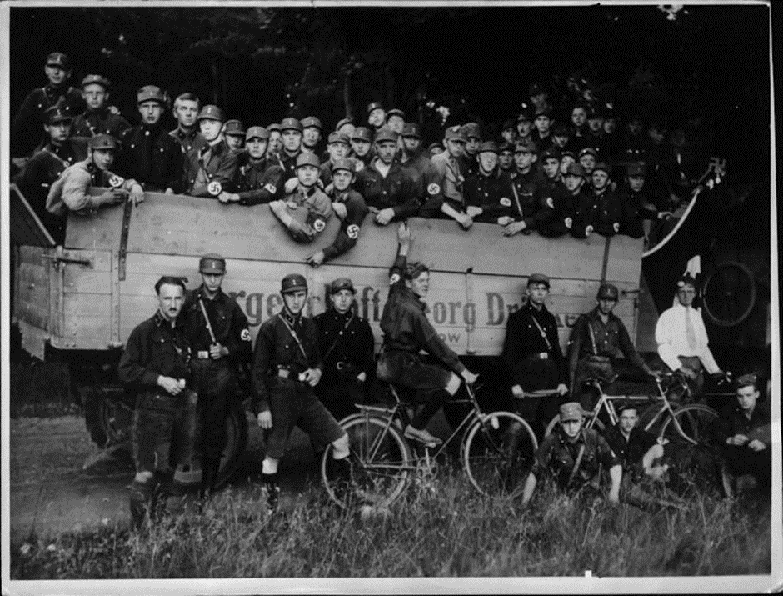
Source 3
Photograph, NSDAP ‘Uckermärker Day’
in Prenzlau, July 1928.

Slide 13
Questions
1. Write down three things you can see in this photograph of NSDAP members.
2. What can you infer from the photograph about the membership and beliefs or values of the party?
3. Why do you think this photograph was taken?

Slide 14
Impact of the First World War
  Due to wartime propaganda, many soldiers believed the war could have been won and felt betrayed by the government.
  Returning soldiers faced unemployment and little help from the government.
  Young men, who were too young to have served in the war, felt they had missed out on the adventure and comradery of war and wanted to prove themselves as masculine through fighting.

Slide 15
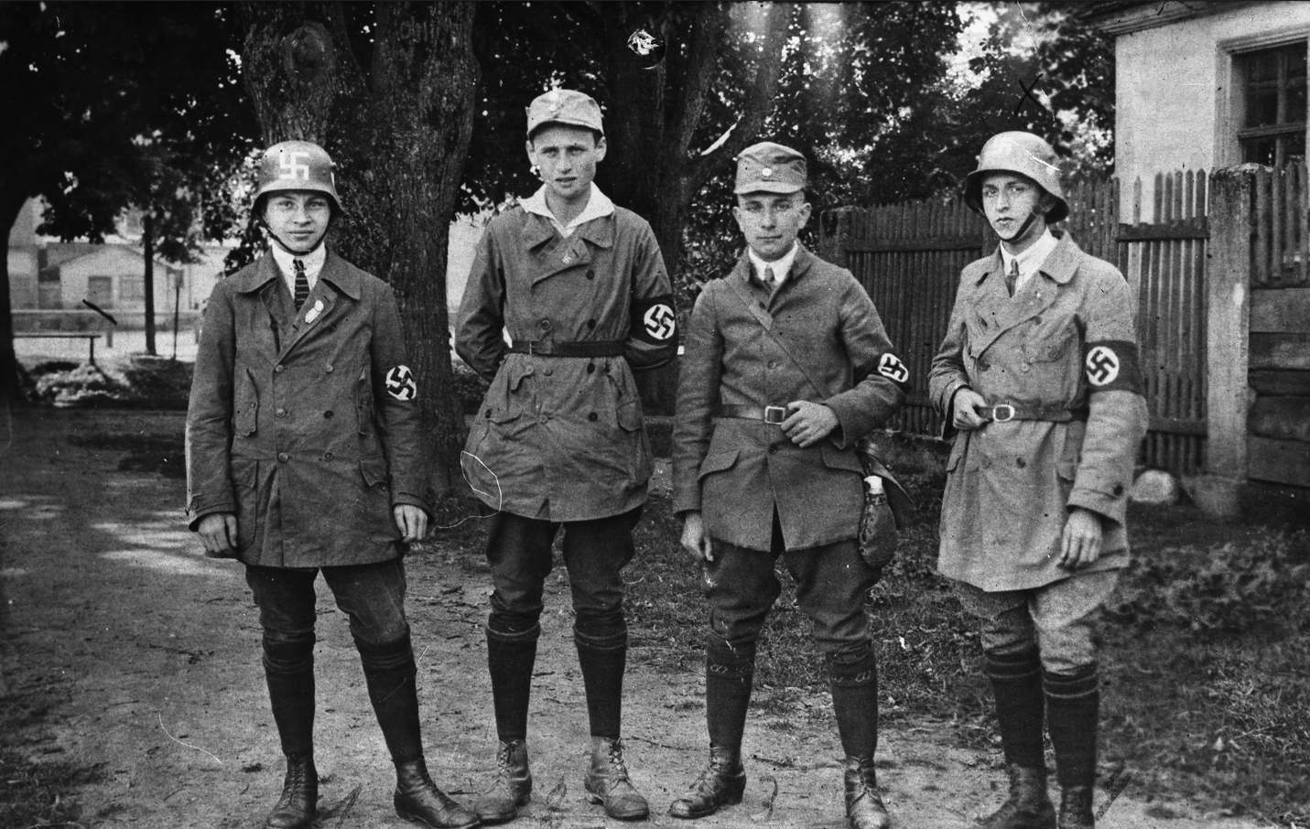
Source 4
Photograph of SA Members at the ‘German Day’ in Neustadt an der Aisch, 1928.

Slide 16
Questions
1. What does this photograph tell you about members of the Nazi Party?
2. Why do you think the people in this photograph might have joined the Nazi party?

Slide 17
Violence
  The Nazis used violence on political opponents such as the Social Democrats and Communists as well as attacking Jews and homosexuals.
  The first Nazi concentration camp, Dachau, was opened on 23 March 1933 to house political opponents.
  There was also violence within the Nazi party, which was encapsulated by the purge of the SA on the ‘Night of the Long Knives’ in 1934.
  On Kristallnacht in 1938, SA and SS members attacked Jewish shops, synagogues and houses, leading to 91 Jewish deaths and thousands being sent to concentration camps.

Slide 18
Source 5
Report from SA Hamburg to 28th SS Standarte, 18 January 1932.
On New Year’s Eve, several SA men and the SS man, Stein, had a punch up with another group of SA men. Following this kerfuffle, a Truppführer demanded the papers from an SA man. The SS man, Stein, then came over to the Truppführer’s table and tried to get the documents back, clearly because he wanted to start another fight.
The Truppführer hadn’t seen the first fight himself, as he only came into the pub soon after it was all over. According to what other guests and other SA men have said, it was at this point that the SS man, Stein, really excelled himself. He smashed up a large, priceless Japanese vase and knocked down an SA man with a wine bottle.

Slide 19
Questions
1. According to Source 5, are the Nazi party following the Ten Commandments of the SA?
2. Why do you think the SA and SS clashed if they were all members of the same party?
3. How do you think violence affected the popularity of the Nazi Party and why?

Slide 20
Rise to power
After Hitler’s release from prison, the Nazi Party took a democratic approach to gaining power.
Hitler reformed the SA and reorganised the Party.
The 25-point programme was reaffirmed in 1926 at the Bamberg conference and appealed to large segments of society.
Nazi propaganda showed Hitler as a strong leader.
In 1929 the Great Depression created mass unemployment in Germany.

Slide 21
Source 6
Leipzig Police Intelligence Report, June 1932.
The NSDAP started their meetings on 1st and 2nd June 1932 with four public gatherings for the unemployed, which in total some 2,000 people attended, including many Communists. […] On 08.06.1932, Reichstag member, [Joseph] Goebbels, spoke at a large rally in Hall 7 of the Leipzig exhibition grounds to an audience of around 2,500 people. Beforehand, there was a march with 2,400 participants. The event went off without incident. However, in the Hain Strasse at around midnight, a large gang of National Socialists attacked three socialists and their female companion, allegedly because one of the students had refused to follow the National Socialists’ demand that he remove his SPD party badge. One National Socialist was arrested. […] At the end of a gathering on the 23.06.1932, […] near Hildegard Strasse the officers were fired upon, and one policeman took a shot in his right hand. The police then returned fire, shooting off four rounds. It is not yet clear whether anyone was hit as a result. Two youths were arrested and taken to the station under suspicion of having been involved in the shooting incident. They have protested their innocence and anyway no weapons were found on them.

Slide 22
Questions
1. What does Source 6 suggest about the popularity of the NSDAP in the early 1930s? Explain your answer.
2. In comparison to Source 1, how did NSDAP meetings change between 1926 and 1932?
3. What factors do you think could have influenced these changes?

Slide 23
Glossary
Fascism – A form of far-right ultranationalist politics.
Dawes agreement – September 1924, lowered reparations payments and Germany received 800 million marks from the USA to help with her recovery
NSDAP - National Socialist German Workers' Party (German: Nationalsozialistische Deutsche Arbeiterpartei), commonly known as the Nazi party.
SA – Sturmabteilung/Stormtroopers, paramilitary wing of the Nazi party who attacked political enemies.
Uckermärker Day - the Nazi Party staged propaganda events that celebrated the nation or the region to increase support. Its first Uckermärker Day, which took its name from the region northeast of Berlin, brought members together in Prenzlau for a day of patriotic festivities.

Slide 24
Glossary continued…
Fatherland – a nationalist term used to unite Germans in terms of birthplace, race, culture and traditions of ancient Germany.
Third Reich – Reich means Empire. The Nazi party claimed they were the successors to the Roman Empire and German Empire.
SS – The Schutzstaffel was formed in 1925 to be Hitler’s personal bodyguard. In 1929 Heinrich Himmler expanded the SS as an elite force which overruled other organisations such as the SA.
Truppführer – an SA troop/unit leader
Reichstag – German parliament
Orator – a public speaker, especially one who is eloquent or skilled

