Slide 1


The Far-Right in Historical Context
Ceridwen Gulmohamed Alice Yardley Roland Clark Tim Grady

Slide 2
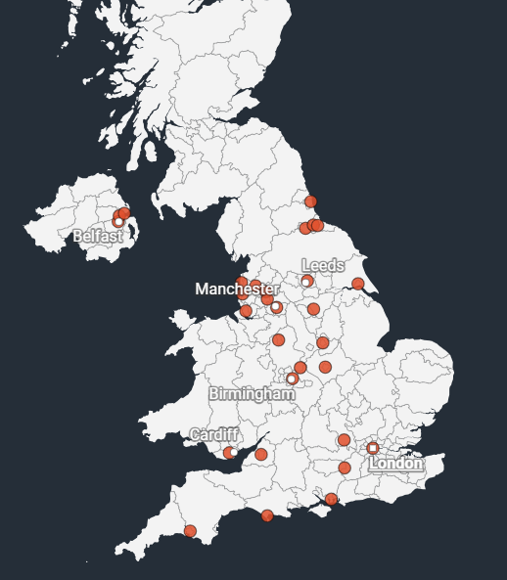
Summer Riots
Over 400 people arrested
Mosques, libraries and hotels vandalized
Organized through social media
Foreigners targeted
‘Mapping far-right riots in the UK’, Al Jazeera, 7 August 2024. https://www.aljazeera.com/news/2024/8/7/mapping-far-right-riots-in-the-uk

Slide 3
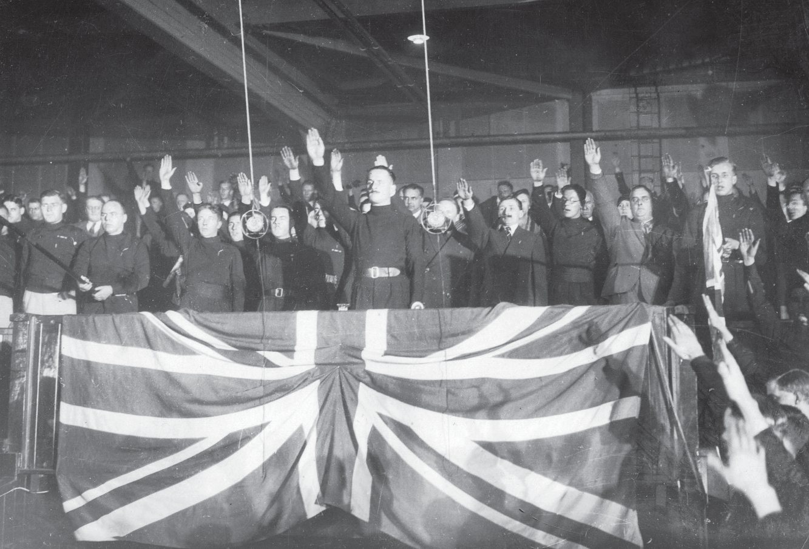
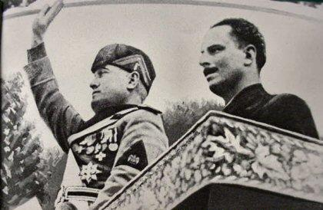
Fascism in Britain
Oswald Mosley and Benito Mussolini in Rome.
BUF rally in Manchester in 1934.

Slide 4
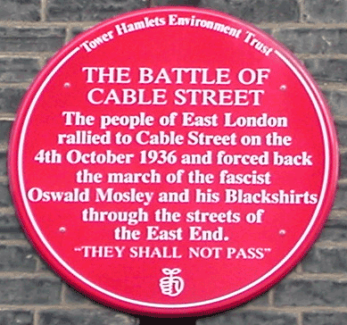
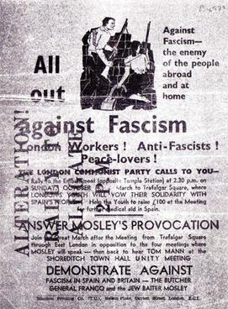
The Battle of Cable Street (1936)
Watch: ‘The Bloody Battle of Cable Street’, Youtube
https://www.youtube.com/watch?v=ozndljflUgU

Slide 5

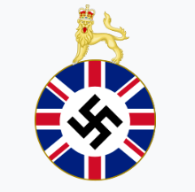
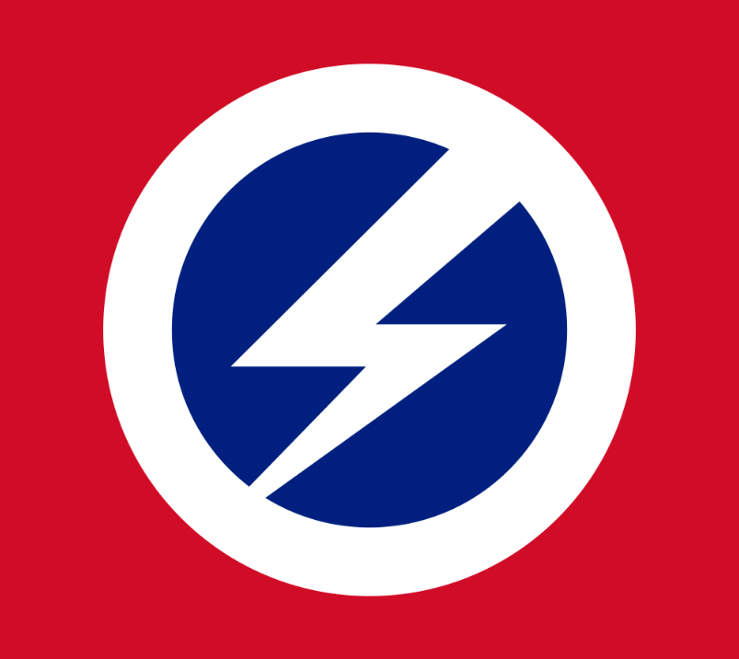



British Fascisti (1923-1934)
Imperial Fascist League (1929-1939)
British Union of Fascists (1933-1940)
Union Movement (1948-1973)
National Front (1967-Present)
English Defence League (2009-Present)

Slide 6
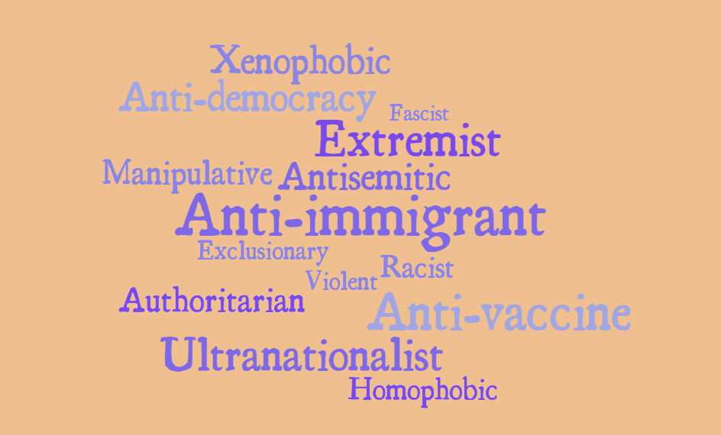

Slide 7
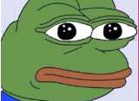
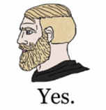

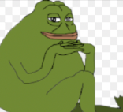
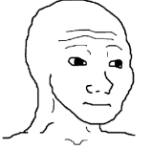
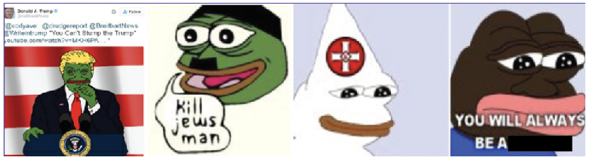
Alt-Right Memes

